Slide 1

Kush Garg
2111981293

Slide 2
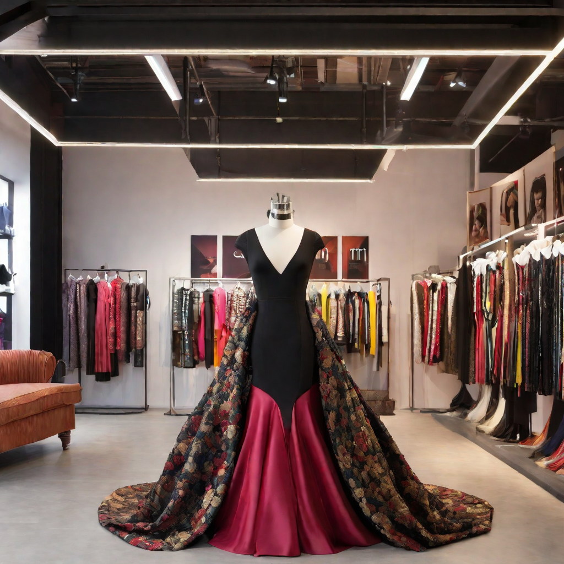
IDEA : Infinity, a fashion studio
Inspiration:
Infinity is inspired by the idea of creating a seamless and dynamic user experience in the fashion studio. We wanted to provide a platform where users could easily browse and purchase fashion apparel, accessories, and jewelry, while also being able to customize their own designs and create unique pieces.
Technology:
Infinity is built using React JS, HTML, CSS, JS, Framer-Motion, and GSAP. These technologies allowed me to create a responsive and interactive website that could adapt to different screen sizes and devices, while also providing a smooth and seamless user experience.

Slide 3



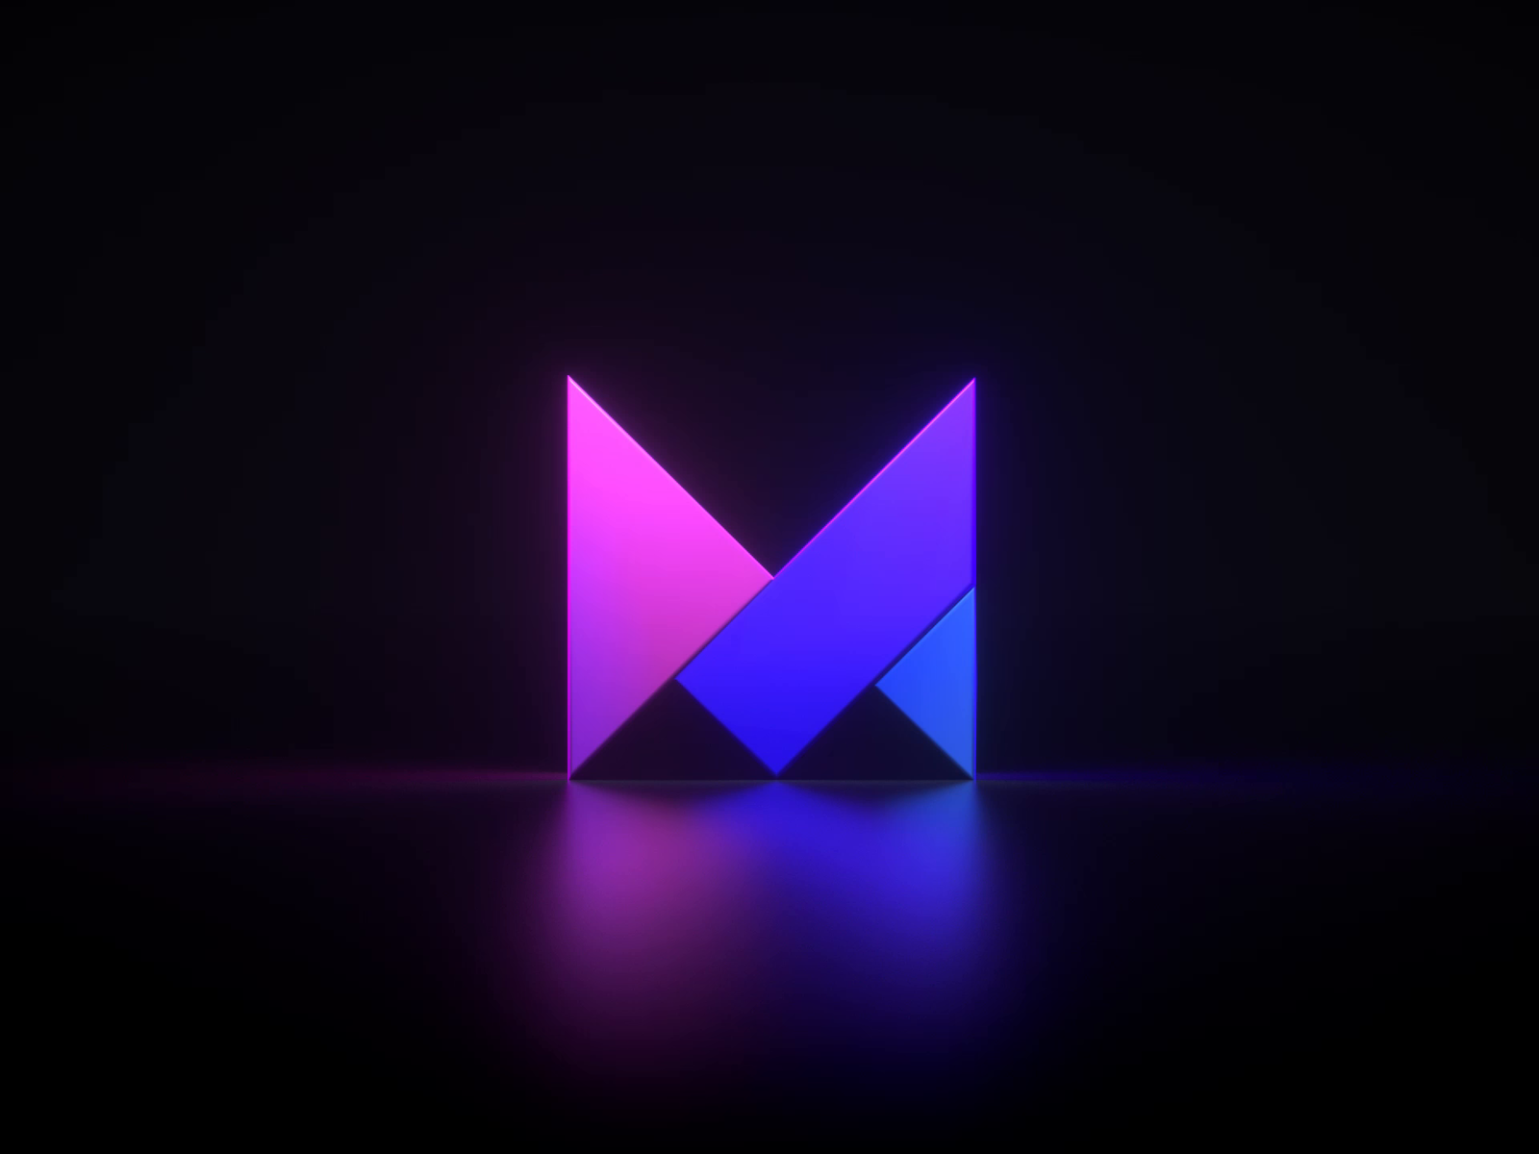
Concept : Building with React, Framer Motion, GSAP, and CSS
React JS
Infinity is built using React, a popular JavaScript library for building user interfaces. React's component-based architecture allows for efficient development and easy maintenance.
Framer-Motion
Framer Motion is a powerful animation library for React that allows for smooth and seamless animations. Motion is used to create dynamic and engaging user experiences.
GSAP
Green Sock Animation Platform, is a JavaScript animation library that allows for high-performance animations and effects, stunning visual effects and transitions.
CSS
Cascading Style Sheets, is a fundamental technology for web design and development that enables the creation of visually appealing and interactive user interfaces.

Slide 4
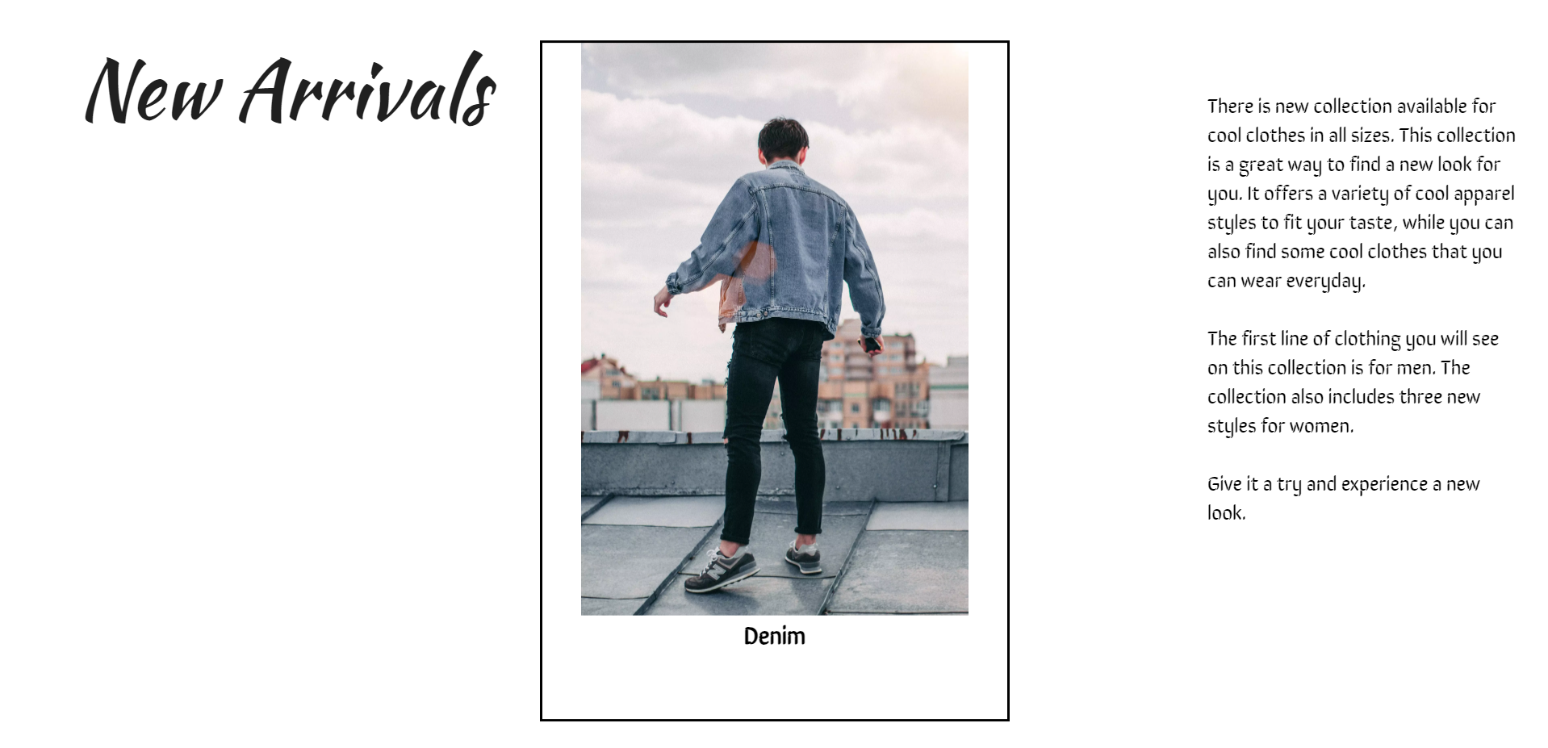
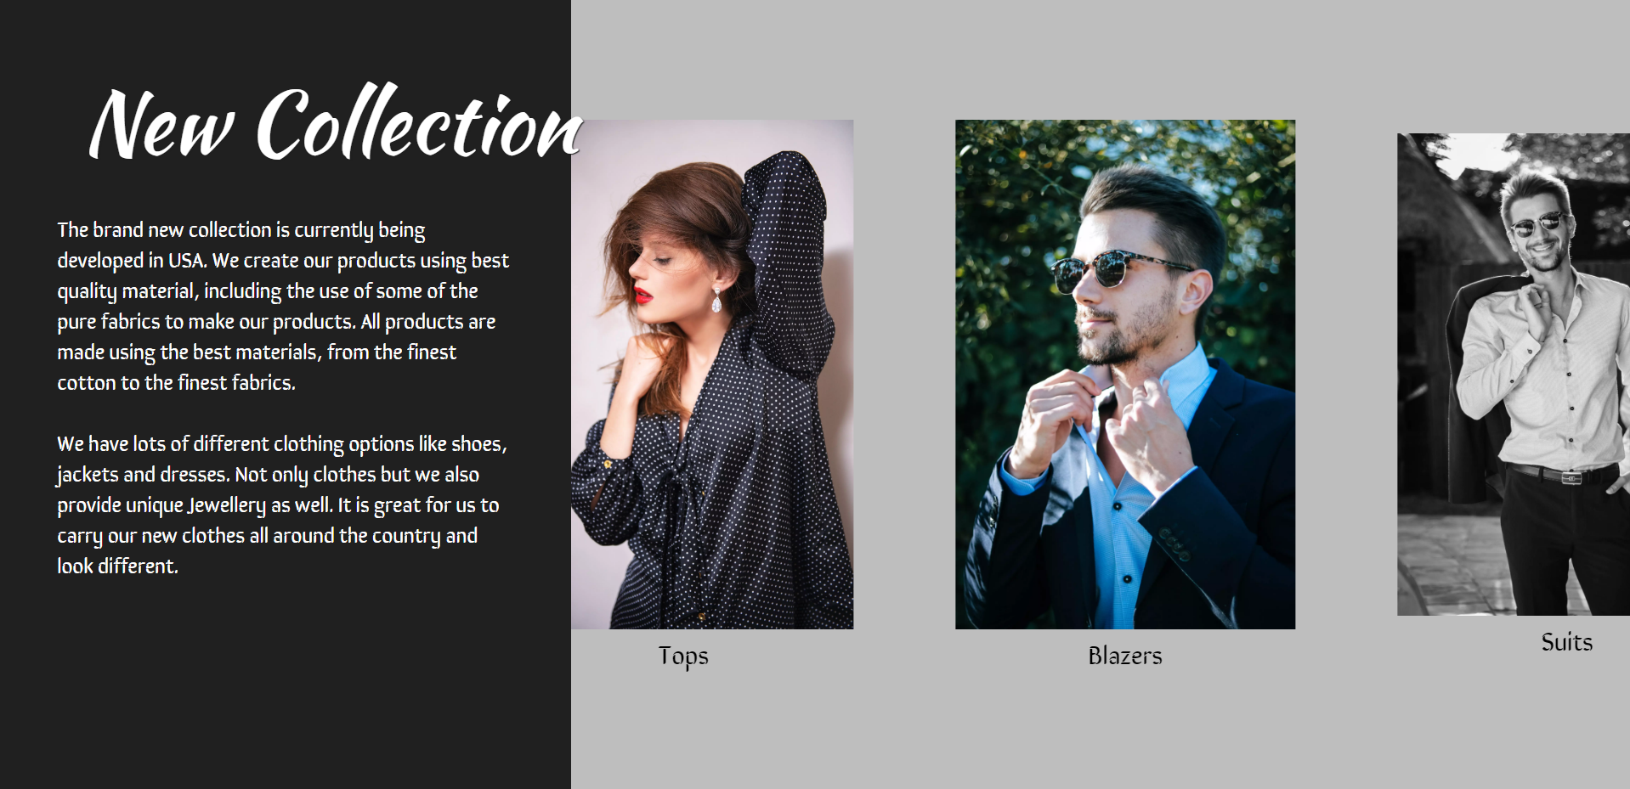
Application : Infinity Fashion Studio
Infinity provides a platform for fashion brands to display and sell their products to a global audience.

Slide 5
Areas For Improvement
Improving readability and keep the content clear and concise.
Integrating user reviews and comments.
Connecting the website to social media.
Adding the search and navigation features.
Implementing personalization features based on preferences.

Slide 6

Thank You
Thank you for taking the time to learn about Infinity and its potential. I hope this presentation has been informative and inspiring.

